Slide 1

Inflammation
James L. Fishback, M.D.
Associate Professor
University of Kansas School of Medicine

Slide 2
Inflammation
Definition
PHASES OF INFLAMMATION
Initiation
Amplification
Termination
“Inflammation is a reaction of a tissue and its microcirculation to a pathogenic insult. It is characterized by the generation of inflammatory mediators and movement of fluid & leukocytes from the blood into extravascular tissues.” Rubin pg. 38

Slide 3
Inflammation
What MUST be known!
Understanding pathogenic mechanisms is diagnostically important
Amplification of the initial response is key
Inflammation persists until the inciting stimulus is removed and the mediators are dissipated or inhibited
Inflammation is potentially dangerous, and must usually be constrained
Therapeutic strategies target critical control points in pro-inflammatory pathways

Slide 4
Inflammation
What MUST be known!
Understanding pathogenic mechanisms is diagnostically important

Slide 5
Inflammation
Cardinal Signs (Celsus, 2 AD)
Redness (rubor)
Swelling (tumor)
Heat (calor)
Pain (dolor)
Loss of function (functio laesa) (the fifth cardinal sign was, supposedly, added by Virchow)

Slide 6
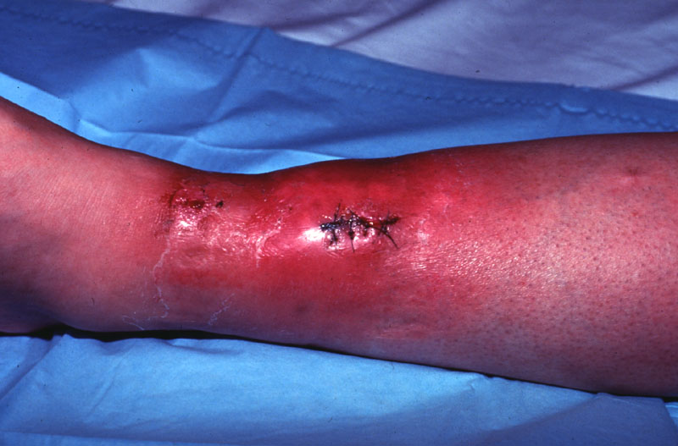
Inflammation
Cardinal Signs
Notes:
Patient with a Methicillin-resistant Staphylococcus aureus wound infection, and classic signs of inflammation.

Slide 7
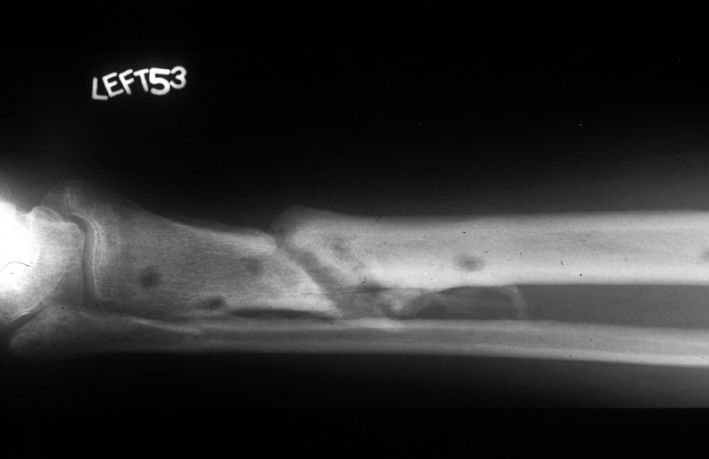
Inflammation
Cardinal Signs
Notes:
X-ray of previous patient showing non-union of fracture. Holes are from orthopedic screws.

Slide 8
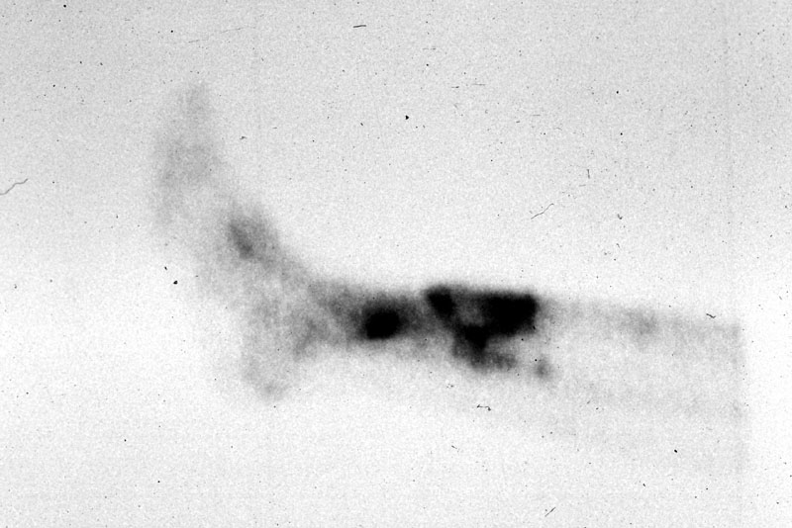
Inflammation
Cardinal Signs
Notes:
Bone scan of same patient, showing uptake in area of active inflammation.

Slide 9
Inflammation
Phases of Acute Inflammation
Initiation -
  Stimulation (injury) with changes in micro-vasculature
  Structural changes leading to extravasation
  Emigration of WBCs to the site of injury
Amplification - Both soluble mediators and cellular inflammatory systems are activated and amplified
Termination - accomplished by specific inhibition or dissipation of the mediators

Slide 10
Inflammation
Acute vs. Chronic Inflammation
Acute inflammation
  Accumulation of fluid and plasma components in the affected tissue
  Intravascular stimulation of platelets
  Presence of polymorphonuclear leukocytes (PMNs)
Chronic inflammation
  Plasma cells, lymphocytes, and macrophages

Slide 11
Inflammation
Outcomes of Acute Inflammation
Resolution (the hoped-for result)
Abscess (via liquifactive necrosis)
Scar (sometimes occurs even if pathogen is eliminated)
Persistent inflammation (chronic inflammation) – due to a failure to completely eliminate the pathological insult (injury)

Slide 12
Inflammation
A dynamic continuum of change
^{Resolution with scarring*}
^{Resolution}
^{Inciting}
^{Stimulus}
^{Chronic-active}
^{Inflammation}
^{Acute}
^{Inflammation}
^{Chronic}
^{Inflammation}
^{Resolution with}
^{scarring*}
^{Abscess}
^{*The longer the stimulus}
^{persists, the greater the}
^{scarring will be.}

Slide 13
Inflammation
The Triple Response
Sir Thomas Lewis (1927)
  Inconstant and transient vasoconstriction (seconds to minutes)
  Vasodilation of pre-capillary arterioles
  Stasis and margination, with an increase in permeability of the endothelial cell barrier
    “Classically, this type of leakage affects only venules 20-60 mm in diameter (post-capillary venule)”

Slide 14
Inflammation
Normal Regulation of Vascular Permeability
“Alterations in the anatomy and function of the microcirculation are among the earliest responses to tissue injury and may promote fluid accumulation in tissues”

Slide 15
Inflammation
Normal Regulation of Vascular Permeability
Starling’s law (see Fig. 2-6): the hydrostatic pressure of the blood is normally nearly balanced by the oncotic pressure of plasma proteins*
*The net result is that there is a continuous movement of fluid from the intravascular compartment into the tissues via the pre-capillary arteriole, where it is either transported away by lymphatics, or reabsorbed in the post-capillary venule

Slide 16
Inflammation
Normal Regulation of Vascular Permeability
Extravascular fluid
(little protein or pressure)
^{Hydrostatic}
^{pressure}
^{Oncotic}
^{pressure}

Slide 17
Inflammation
Pathogenesis of Edema
Non-inflammatory edema, e.g.:
  Pulmonary edema due to heart failure (increased hydrostatic pressure)
  Nephrotic syndrome (decreased oncotic pressure)
Inflammatory edema, either:
  Direct, irreversible injury - all vessels (burns)
  Transient increase in vascular permeability, i.e., the effect of mediators on post-capillary venules

Slide 18
Inflammation
Increased Hydrostatic Pressure
^{EDEMA -TRANSUDATE}
(protein content low - specific gravity <1.012)
^{Hydrostatic}
^{pressure}
^{Oncotic}
^{pressure}

Slide 19
Inflammation
Decreased Oncotic Pressure
^{EDEMA -TRANSUDATE}
(protein content low: specific gravity <1.015)
^{Hydrostatic}
^{pressure}
^{Oncotic}
^{pressure}

Slide 20
Inflammation
Increased Vascular Permeability
EDEMA -EXUDATE
(protein content high: specific gravity >1.015)
^{Hydrostatic}
^{pressure}
^{Oncotic}
^{pressure}
Diapedesis

Slide 21
Inflammation
Phases of Acute Inflammation
Initiation
  Initial vasoconstriction, followed by a longer period of vasodilation
  Leakage of fluid and plasma from the intravascular compartment (increased permeability)
  Stasis, with transmigration of leukocytes and erythrocytes into extravascular tissue

Slide 22
Inflamasyon
İnflamasyonun Kimyasal Mediyatörleri
Vazoaktif aminler
Kompleman sistemi
Kinin sistemi
Koagülasyon sistemi
Fibrinolitik yol
Arakidonik asit metabolitleri
PAF (Platelet activating factor)
Sitokinler
Nitrik oksid

Slide 23
Inflammation
Sources of Inflammatory Mediators
Cell-derived, e.g.:
  Proteins sequestered in granules
  Membrane phospholipids (via arachidonic acid metabolism)
  Vasoactive amines (mast cells and platelets)
Inactive precursors in plasma, e.g.:
  Complement proteins (C3a, C5a)
  Coagulation proteins initiated by Hageman factor (FDPs)

Slide 24
Inflammation
Chemical Mediators of Inflammation
Arachidonic acid metabolites
  Synthesized from cell membrane phospholipids though the action of phospho-lipases (inhibited by corticosteroids)
  Form leukotrienes via 5-lipoxygenase
  Form prostaglandins and thromboxane A₂ via cyclo-oxygenase (COX-1 inhibited by aspirin and indomethacin, COX-2 inhibitors now coming on the market)

Slide 25
Inflammation
Chemical Mediators of Inflammation
Vasoactive amines (mast cells and platelets)
  Histamine – abundant in granules of mast cells, which are abundantly arrayed around blood vessels.
  Serotonin – actions similar to histamine. Found in platelets. Released after platelet aggregation, or under the influence of platelet activating factor (PAF).

Slide 26
Inflammation
Chemical Mediators of Inflammation
Complement cascade system
  Classic and alternative pathways
    C3 is the critical control point, and interacts with both pathways
    C3a and C5a are known as “anaphylotoxins”, and are capable of releasing histamine from mast cells, along with potent chemotactic abilities (C5a)
    Membrane attack complex (MAC) is the active agent of complement lysis and consists of C5-9

Slide 27
Inflammation
Chemical Mediators of Inflammation
Kinin system
  Vasoactive peptides called kininogens generated by proteases called kallikreins
  Most important product is bradykinin
    Vascular dilation
    Pain
  Kallikrein is a potent activator of Hageman factor

Slide 28
Inflammation
Chemical Mediators of Inflammation
Coagulation pathway
Fibrinolytic pathway
  Both systems are induced by activated factor XIIa (Hageman factor or tissue factor)
    See Fig. 2-14, showing Hageman factor interaction with the kinin and complement cascade
  The coagulation and fibrinolytic systems complement and counterbalance each other
  Most important molecules are fibrinogen, fibrin, thrombin, plasminogen, and plasmin

Slide 29
Inflammation
Chemical Mediators of Inflammation
Platelet activating factor
  Numerous effects, including vasodilation and increased vascular permeability, with 100-10,000-fold increased activity, with respect to those actions, when compared to histamine

Slide 30
Inflammation
Kimyasal İnflamasyon Mediyatörleri
Sitokinlerin önemi
  Interleukin 1- endoteliyal hücre aktivasyonu
  Interleukin 2 (T hücre büyüme faktörü)
  TNFα (kaşektin)
  TNF β (lenfotoksin)
  Muhtelif koloni stimüle edici faktör (etki ettikleri stemm cell’e göre isimlendirilir)
  Kemokinler – kemotaksi için önemlidir

Slide 31
Inflammation
Kimyasal İnflamasyon Mediyatörleri
Nitrik oksid (NO)
  NO sentaz (NOS) ile oluşur
    Devamlı olarak endoteliyal ve nöronal hücrelerde ekspresse olur. Kalsiyum influx’ı ile hızla artabilir.
    Indüklenebilir NOS – Makrofaşlarda TNF-α veya IFN-γ ile indüklenir
  Kuvvetli vazodilatör
  Septik şok patogenezinde rol oynar

Slide 32
Inflammation
Leukocyte Extravasation and Phagocytosis
Margination, rolling, and adhesion
Transmigration (diapedesis)
Migration toward the site of injury along a chemokine gradient

Slide 33
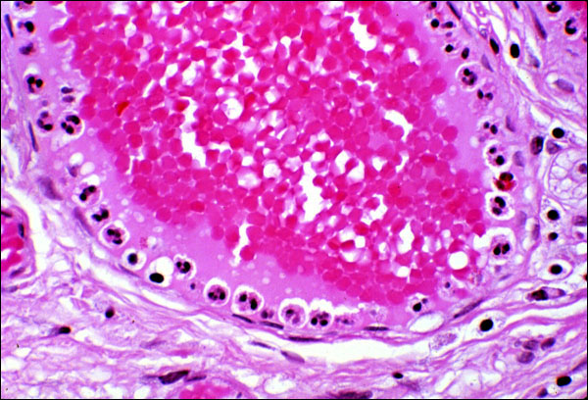
Inflammation
Margination and Pavementing
Notes:
Polymorphs at margin of a vessel in acutely inflamed tissue.

Slide 34
Sequential involvement of adhesion molecules
Rolling → Adhesion → Transmigration
^{Central Axial Stream}
SELECTINS (E&P)
INTEGRINS & Ig-LIKE MOLECULES (ICAM, VCAM)
Qualitative and Quantitative Endothelial and PMN Changes
Notes:
E&P selectins contribute to rolling. ICAM and VCAM, along with PMN integrins are active in the transmigration process.

Slide 35
Inflammation
Adhesion Molecule Modulation
P-selectin is redistributed to the cell surface from the Weibel-Palade bodies due to stimulation by thrombin, histamine, and Platelet Activating Factor (PAF)
Induction of E-selectin on endothelium by IL-1 and TNF
Increased avidity of binding of integrins (conformational change)

Slide 36
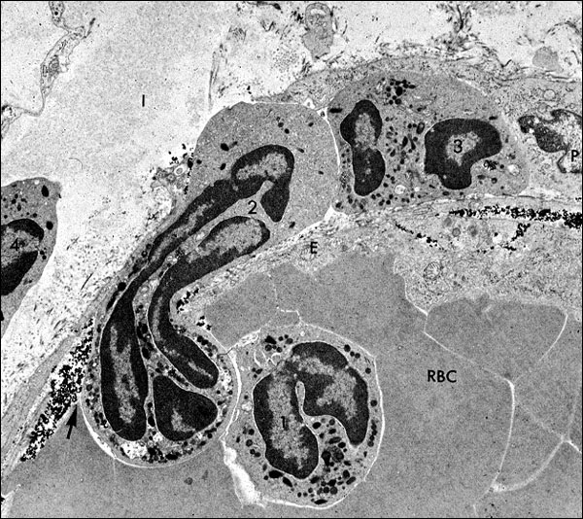
Inflammation
Transmigration
Notes:
EM showing transmigration of a PMN through a vascular wall.

Slide 37
Inflammation
What must be known
Understanding pathogenic mechanisms is diagnostically important
Amplification of the initial response is key

Slide 38
Inflammation
Phases of Inflammation - Amplification
PMNs and macrophages are recruited to the site of injury from peripheral blood by chemokines, principally IL-8, plus c5a, TGF-β, and Platelet-derived Growth Factor
IL-1 and TNF cause the release of post-mitotic reserve granulocytes from the marrow, plus induce the production of Colony Stimulating Factors (CSF)

Slide 39
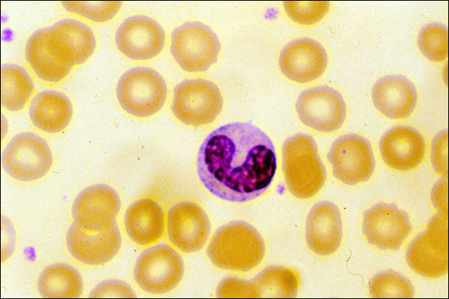
Inflammation
Amplification – left shift
Notes:
Immature band form of neutrophil in peripheral blood.

Slide 40
Inflammation
Phases of Inflammation - Amplification
Edema
PMNs
Monocytes/Macrophages
REPAIR →
(fibroblasts)
Activity
1
2
3
DAYS

Slide 41
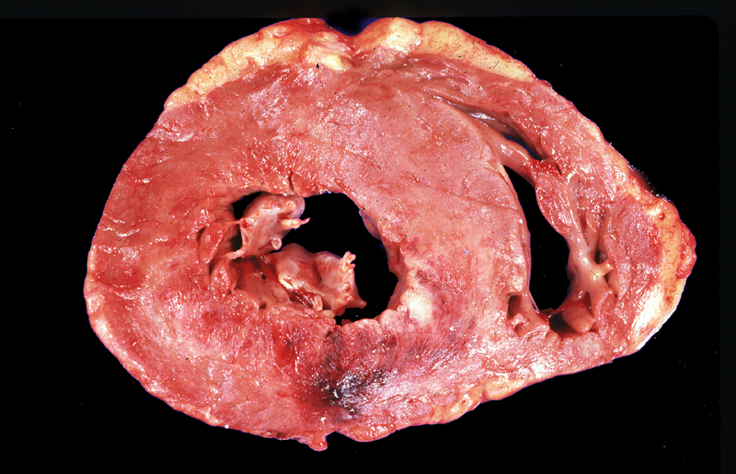
Inflammation
Acute MI (<10 hours), Gross
Notes:
Acute MI, showing hemorrhage in the posterior (bottom of slide) LV.

Slide 42
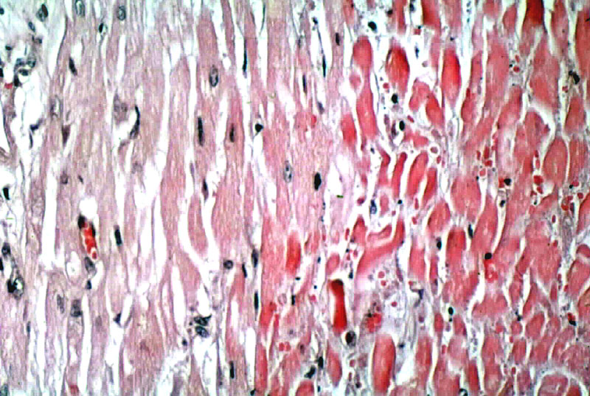
Inflammation
Acute MI (<10 hours), Micro
Notes:
H&E showing normal myocardium on left (with some evidence of hypertrophy), and early infarction on the right. Note the brick-red color and lack of nuclei. No inflammatory cells have yet appeared.

Slide 43
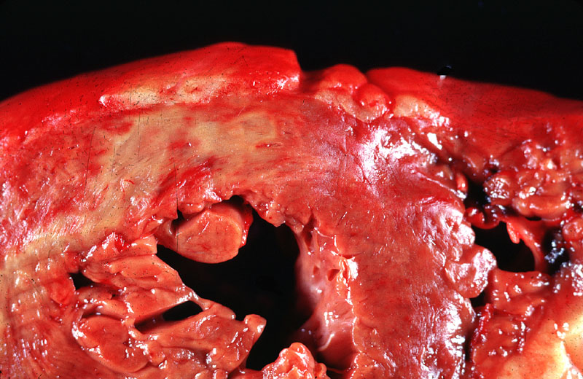
Inflammation
Acute MI (24-72 hours), Gross
Notes:
Further evolution of an MI, showing yellowish discoloration, due to infiltration by PMNs.

Slide 44
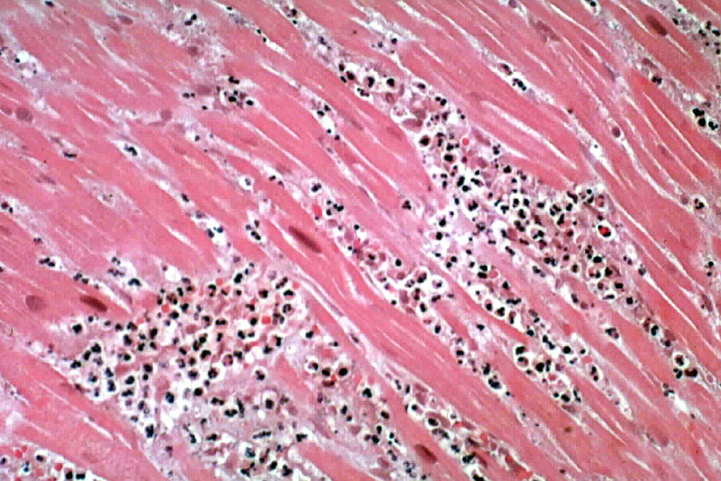
Inflammation
Acute MI (24-72 hours), Micro
Notes:
H&E showing predominance of neutrophils and dead myocardium.

Slide 45
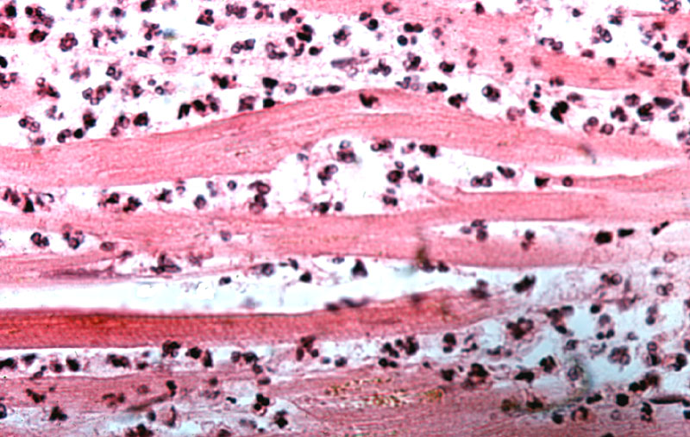
Inflammation
Acute MI (24-72 hours), micro
Notes:
Hi power of same. Note poly-lobated nuclei, typical of PMNs. The myocardial cells are all necrotic, lacking nuclei.

Slide 46
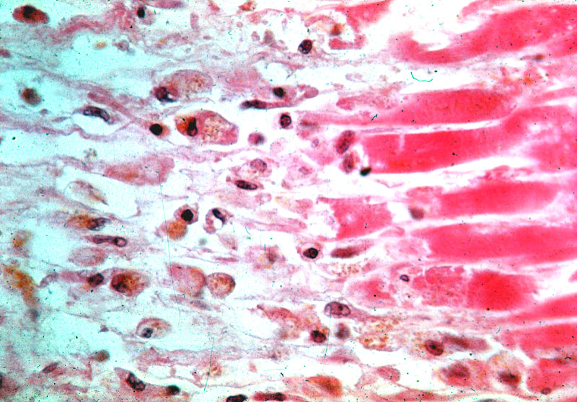
Inflammation
Acute MI (>72 hours) with Macrophages
Notes:
Macrophages, recognizable by their large size, eccentric nuclei and clear cytoplasm, often containing lipid, nuclear debris, or hemosiderin pigment.

Slide 47
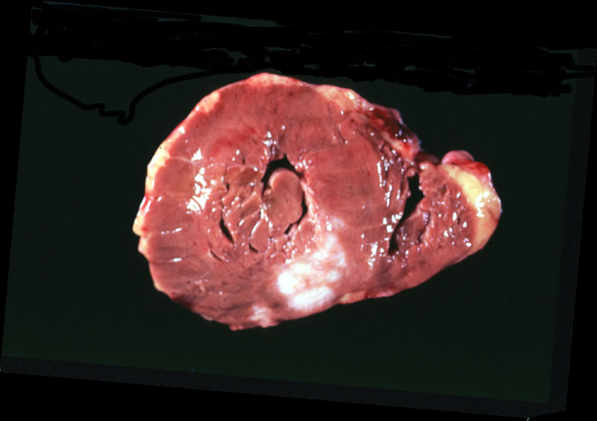
Inflammation
Remote MI (> 6 weeks), Gross
Notes:
Old MI showing a mature, white, collagenous scar.

Slide 48
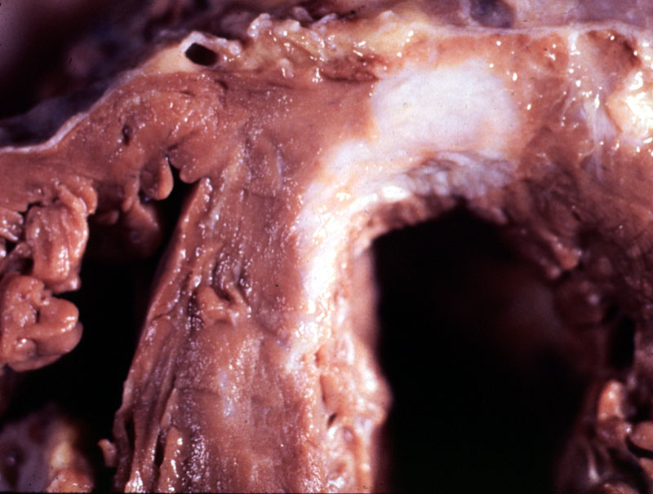
Inflammation
Remote MI (> 6 weeks), Fibrosis, Detail
Notes:
Same as previous.

Slide 49
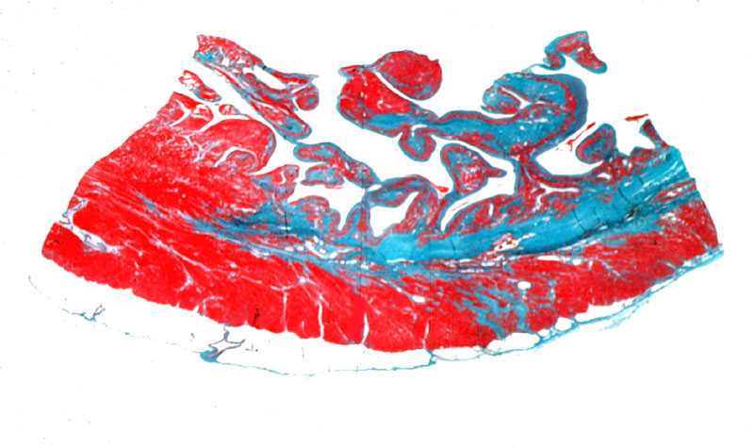
Inflammation
Remote MI (>6 weeks), Trichrome
Notes:
Whole mount, demonstrating collagen scar (blue-green on trichrome stain).

Slide 50
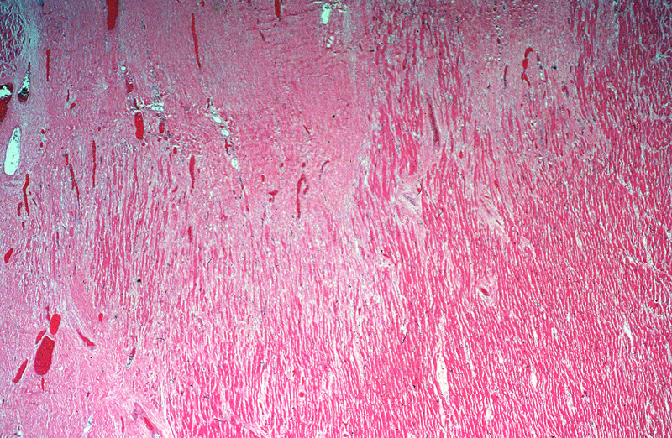
Inflammation
Remote MI, Micro
Notes:
Low power H&E of an old MI, showing mature collagenous scar, blending with normal cardiac muscle. Scar is not capable of rhythmic contraction. Cardiologists say that scarred myocardium is “hypokinetic”.

Slide 51
Inflammation
Chemotaxis – Definition
“Chemotaxis refers to the process of directed cell migration, which is a dynamic and energy-dependent activity”. Rubin, pg. 58.

Slide 52
Inflammation
Chemotaxis
Exogenous mediators, e.g.:
  N-formyl methionine terminal amino acids from bacteria
  Lipids from destroyed or damaged membranes (including LPS)
Endogenous mediators, e.g.:
  Complement proteins (C5a)
  Chemokines, particularly IL-8
  Arachidonic acid products (LTB₄)

Slide 53
Inflammation
Chemotaxis
“Initial recruitment of macrophages depends largely on C5a and arachidonic acid metabolites, whereas following injury, the prolonged recruitment from 6 to 48 hours is mediated by the the production of chemotactic cytokines” Rubin, pg. 61.

Slide 54
Inflammation
Cytokine Networks (Figs. 2-23 and 2-24)
The local secretion of cytokines at the site of injury is the primary means of regulating the inflammatory response
The macrophage is the pivotal cell, secreting many different molecules, under various influences, two of the most powerful being lipopolysaccharide (LPS – Gram negatives) and IFN-γ (viruses, et al)

Slide 55
Inflammation
Functional Role of Cytokines (Fig. 2-23)
Autocrine
Paracrine (local effects, chemokines)
Endocrine (systemic response)

Slide 56
Inflammation
Inflammatory Cell Activation
PMNs are activated by many substances, including:
  The Fc portion of IgM and IgG molecules
  C5a, C3b, and iC3b
  Leukotriene B₄
  Cytokines (TNF-α)
  Formylated chemotactic peptides derived from bacteria

Slide 57
Inflammation
Activation of Inflammatory Cells
Macrophages are activated by many substances, including:
  Lipopolysaccharide (LPS), found in Gram-negative bacteria
  Platelet activating factor (PAF)
  Cytokines produced by T-cells, particularly interferon gamma (IFN-γ)
  Fibronectin, a component of extracellular matrix

Slide 58
Inflammation
Platelet Activating Factor (PAF)
Cell Activation (inflammatory, endothelial and tissue cells)
Platelet Activating Factor (phospholipase A₂)
Platelet
Activation
Neutrophil/Macrophage
Activation
Vasculature
Smooth Muscle
Contraction
Granule
release
Vasoconstriction
Chemotaxis
Aggregation
& adhesion
Vasodilation*
Production of
oxygen inter-
mediates
Production of
Eicosanoids
Increased vascular
permeability*
* 100 to 10,000 times more potent than histamine

Slide 59
Inflammation
Mechanisms of Inflammatory Cell Function
The formation of a ligand-receptor complex leads to activation of a specific phospho-diesterase (phospholipase C) in the plasma membrane (stimulus-response coupling)
  Increased phospholipid metabolism
  Increased intracellular calcium
  Activation of protein kinases and phosphatases

Slide 60
Inflammation
Bactericidal activity
Activated oxygen species
  Superoxide (.O₂) - formed via NADPH oxidase
  Hydrogen peroxide (H₂O₂) - formed via spontaneous dismutation of superoxide)
  Hypochlorous acid (HOCl) (Myeloperoxidase)
    Probably the primary bactericidal agent in neutrophils
    Myeloperoxidase converts H₂O₂ into HOCl.
  Hydroxl radical (.OH)

Slide 61
Inflammation
Neutrophil Granules
Primary - contain serine proteases, lysozyme and phospholipase A₂
Secondary - similar to primary, but also contain lactoferrin and collagenase
Tertiary - present at the leading edge of migrating PMNs, contain gelatinases that are capable of degrading basement membrane

Slide 62
Inflammation
Bactericidal activity
Non-oxidative bacterial killing
  Lysosomal hydrolases (1º and 2º granules)
  Bactericidal/permeability-increasing protein
  (1º granules - affects Gram-negatives)
  Defensins (1º granules)
  Lactoferrin (2º granules - chelates iron)
  Lysozyme (1º and 2º granules, lysosomes)
  Bactericidal proteins of eosinophils

Slide 63
Inflammation
Tissue Injury by Inflammatory Cells
The relatively primitive and non-specific immune effects of polymorphonuclear leukocytes and macrophages upon invading microorganisms are also capable of damaging the host by the extracellular release of enzymes and activated oxygen species

Slide 64
Inflammation
Tissue Injury by Inflammatory Cells
"Our arsenals for fighting off bacteria are so powerful, and involve so many different defense mechanisms, that we are more in danger from them than from the invaders. We live in the midst of explosive devices; we are mined."
      Lewis Thomas

Slide 65
Inflammation
Tissue Injury by Inflammatory Cells
Activated oxygen species
  Can migrate through intact plasma membranes
  Initiate lipid peroxidation
  React with DNA
  Oxidize sulfhydryl groups of proteins
  Degrade extracellular matrix components

Slide 66
Inflammation
Tissue Injury by Inflammatory Cells
Lysosomal enzymes
  Since these enzymes are used to degrade microorganisms in lysosomes, obviously they could damage tissue in the extracellular environment
  Usually protease activity is controlled by a variety of anti-proteases present in plasma (α₁-anti-trypsin, α₂-macroglobulin, etc.)

Slide 67
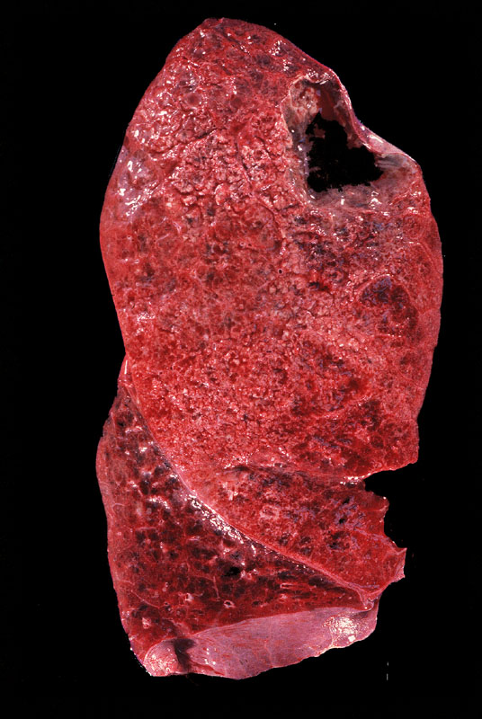
Inflammation
Tissue Injury by Inflammatory Cells
Notes:
Abscess, formed via liquifactive necrosis, primarily due to the action of neutrophils.

Slide 68
Inflammation
Tissue Injury by Inflammatory Cells
Phagocytic cell adherence
  Adherence to basement membranes, other components of the extracellular matrix and other cells by phagocytes enhances the damage caused by reactive oxygen species and lysozyme, because normal inhibitors present in plasma cannot gain access to that space by virtue of the phagocytic cell adherence

Slide 69
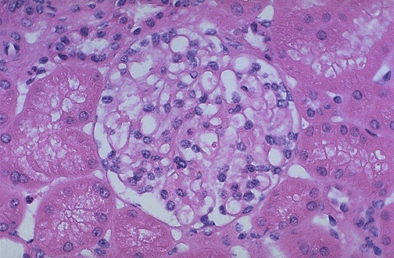
Inflammation
Tissue Injury by Inflammatory Cells
Notes:
Normal glomerulus, containing 50-100 nuclei.

Slide 70
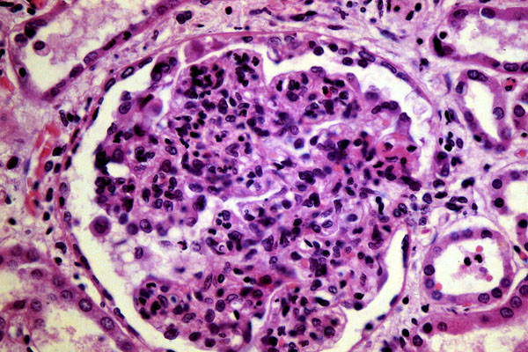
Inflammation
Tissue Injury by Inflammatory Cells
Notes:
Post-streptococcal glomerulonephritis, showing a hypercellular glomerulus. Most of the extra cells are neutrophils, reacting with immune complexes in the glomerular basement membrane. This is a very bad thing for the glomerulus, and it is usually destroyed and heals with a hyaline scar.

Slide 71
Inflammation
Defects in Phagocytosis
Congenital
  Chediak-Higashi Syndrome (autosomal recessive)
    Defective intracellular transport protein, inability to lyse bacteria
  Job Syndrome (Hyper IgE)
  Chronic granulomatous disease (x-linked)
    No oxidative burst
  Myeloperoxidase deficiency

Slide 72
Inflammation
Defects in Phagocytosis
Acquired
  Iatrogenic immunosuppression (most common)
  Overwhelming infections
  Severe trauma or burn
  Diabetes mellitus
  Chronic debilitating disease

Slide 73
Inflammation
What MUST be known!
Understanding pathogenic mechanisms is diagnostically important
Amplification of the initial response is key
Inflammation persists until the inciting stimulus is removed and the mediators are dissipated or inhibited

Slide 74
Inflammation
A dynamic continuum of change
^{Resolution with scarring*}
^{Resolution}
^{Inciting}
^{Stimulus}
^{Chronic-active}
^{Inflammation}
^{Acute}
^{Inflammation}
^{Chronic}
^{Inflammation}
^{Resolution with}
^{scarring*}
^{Abscess}
^{*The longer the stimulus}
^{persists, the greater the}
^{scarring will be.}

Slide 75
Inflammation
Characteristics of acute and chronic inflammation
^{ACUTE}
^{CHRONIC}
Vasodilation and
Increased permeability
Minimal
^{Vascular changes}
Polymorphs
No replication
Mononuclear
Replication
^{Cellular infiltrates}
Minimal -
separation due
to edema
Cellular proliferation
Fibrosis
^{Stromal changes}

Slide 76
Inflammation
Chronic Inflammation
Chronic inflammation may occur as a sequel to acute inflammation, or as a primary immune response to a foreign antigen (usually viral)

Slide 77
Inflammation
Chronic Inflammation
Histologic features
  Mononuclear cells – macrophages, lymphocytes, and plasma cells
  Tissue destruction by ongoing inflammation, thought to be due to cytokines produced locally by the mononuclear cells
  Attempts at healing, including fibroblasts and fibrosis (Chapter 3)

Slide 78
Inflammation
Chronic Inflammation
Monocyte/Macrophages
  Key cell in chronic and granulomatous inflammation
  Reproduce locally, at the site of injury
  Produce numerous cytokines, which continue to recruit additional cells, including more macrophages
  May present antigen to T-cells, producing specific hypersensitivity reactions

Slide 79
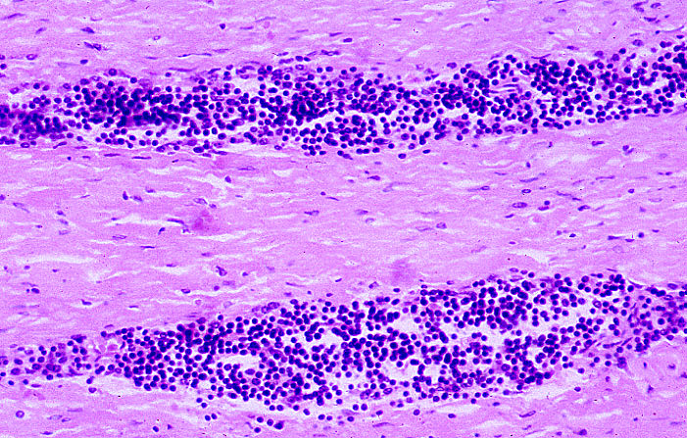
Inflammation
Chronic Inflammation – Syphilitic Aortitis
Notes:
Lymphocytic chronic inflammatory infiltrate in the wall of the aorta in syphilitic aortitis. Lymphocytes and plasma cells are the typical response to spirochete infections, rather than PMNs.

Slide 80
Inflammation
Granulomatous Inflammation
A cellular mechanism for dealing with indigestible substances
The principal cells involved in granulomatous inflammation are macrophages and lymphocytes
Epithelioid histiocytes are the hallmark of granulomatous inflammation

Slide 81
Inflammation
Granulomatous Inflammation
Immunity may be judged by its effect on the invading organism, but an adverse effect on the host is generally termed hypersensitivity
Destruction of tissue is primarily via the action of killer T cells (CD8⁺), directed by macrophages
Hence, the old term for tuberculosis was consumption, for good reason

Slide 82
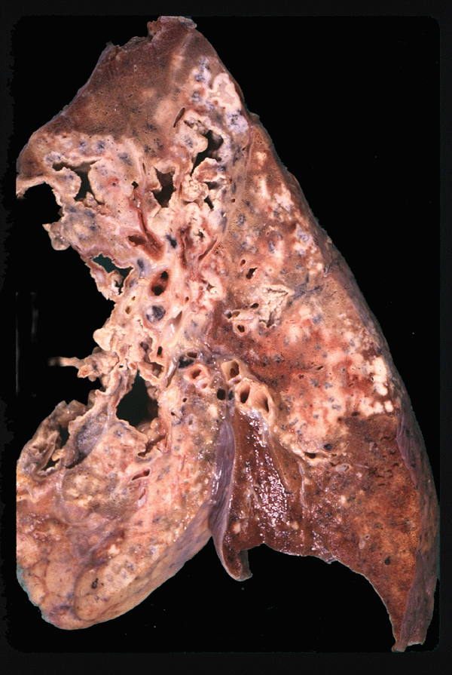
Inflammation
Granulomatous Inflammation
Notes:
Tuberculous lung, showing massive destruction by granulomatous inflammation. This type of response is simply the best the body can do, since the inciting organism cannot be removed. Mycobacteria may live for years, perhaps even a lifetime, within granulomas.

Slide 83
Inflammation
Granulomatous Inflammation
Fibroblasts
Lymphocytes
Macrophages, Epithelioid
Cells, and Giant Cells
^{Caseous Necrosis}
^{Non-caseating Granuloma}
^{Caseating Granuloma}
Notes:
Characteristic arrangement of cells in a granuloma. The extracellular matrix is active in orchestrating the precise alignment of cells. Granulomas often form when indigestible substances are present, such as foreign bodies, or Mycobacteria, which are resistant to oxidative killing.

Slide 84
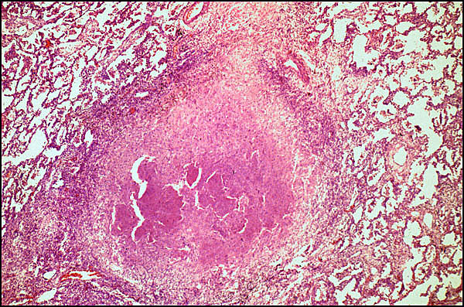
Inflammation
Granulomatous Inflammation
Notes:
Granuloma, H&E, showing Langhans giant cells. These multinucleated cells have macrophage markers on their cell surface, and are apparently the result of fusion of individual macrophages. While useful in diagnosing a granuloma, they are not considered the characteristic cell. That honor belongs to the epitheliod histiocyte, which also has macrophage cell surface markers.

Slide 85
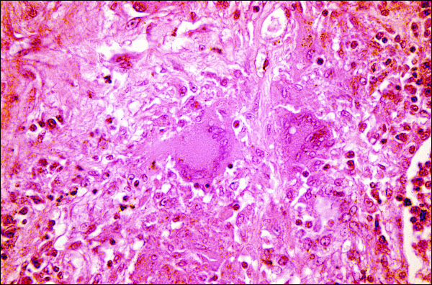
Inflammation
Granulomatous Inflammation
Notes:
Granuloma, H&E, showing Langhans giant cells. These multinucleated cells have macrophage markers on their cell surface, and are apparently the result of fusion of individual macrophages. While useful in diagnosing a granuloma, they are not considered the characteristic cell. That honor belongs to the epitheliod histiocyte, which also has macrophage cell surface markers.

Slide 86
Inflammation
What MUST be known!
Understanding pathogenic mechanisms is diagnostically important
Amplification of the initial response is key
Inflammation persists until the inciting stimulus is removed and the mediators are dissipated or inhibited
Inflammation is potentially dangerous, and must usually be constrained
Therapeutic strategies target critical control points in pro-inflammatory pathways

Slide 87
Inflammation
Systemic Manifestations of Inflammation
Fever - clinical hallmark of inflammation
  Endogenous pyrogens: IL-1 and TNF-α
Leukocytosis - may be neutrophils, eosinophils, or lymphocytes
Leukopenia - rare
Acute Phase Reactants - non-specific elevation of many serum proteins - will markedly increase the “sed rate”

Slide 88
Inflammation
Systemic Manifestations of Inflammation
Shock – most common in Gram-negative septicemia (bacteria in the bloodstream), although it can occur with Gram-positive bacteremia
  Lipopolysaccharide (LPS or endotoxin) of Gram-negatives can produce symptoms of shock when injected into animals
  TNF-α can produce a similar syndrome

Slide 89
Inflammation
Systemic Manifestations of Inflammation
Therapy for fever and inflammation targets arachidonic acid metabolism (aspirin)
Therapy for shock focuses on fluid resuscitation, and proper selection of antibiotics (more to come later)
Experimental therapy for shock using anti-TNF-α, and other antibodies directed against cytokines, has, so far, failed to improve survival

