Slide 1
Clinical research for COVID-19
File created on: 4/26/2020 7:00:38 AM

Slide 2
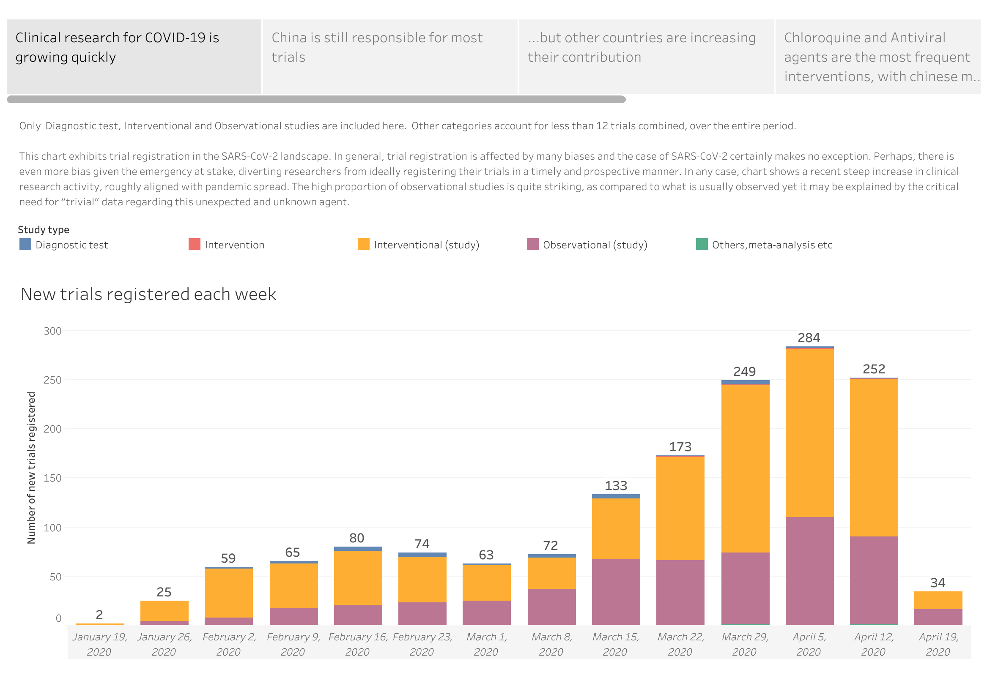

Slide 3
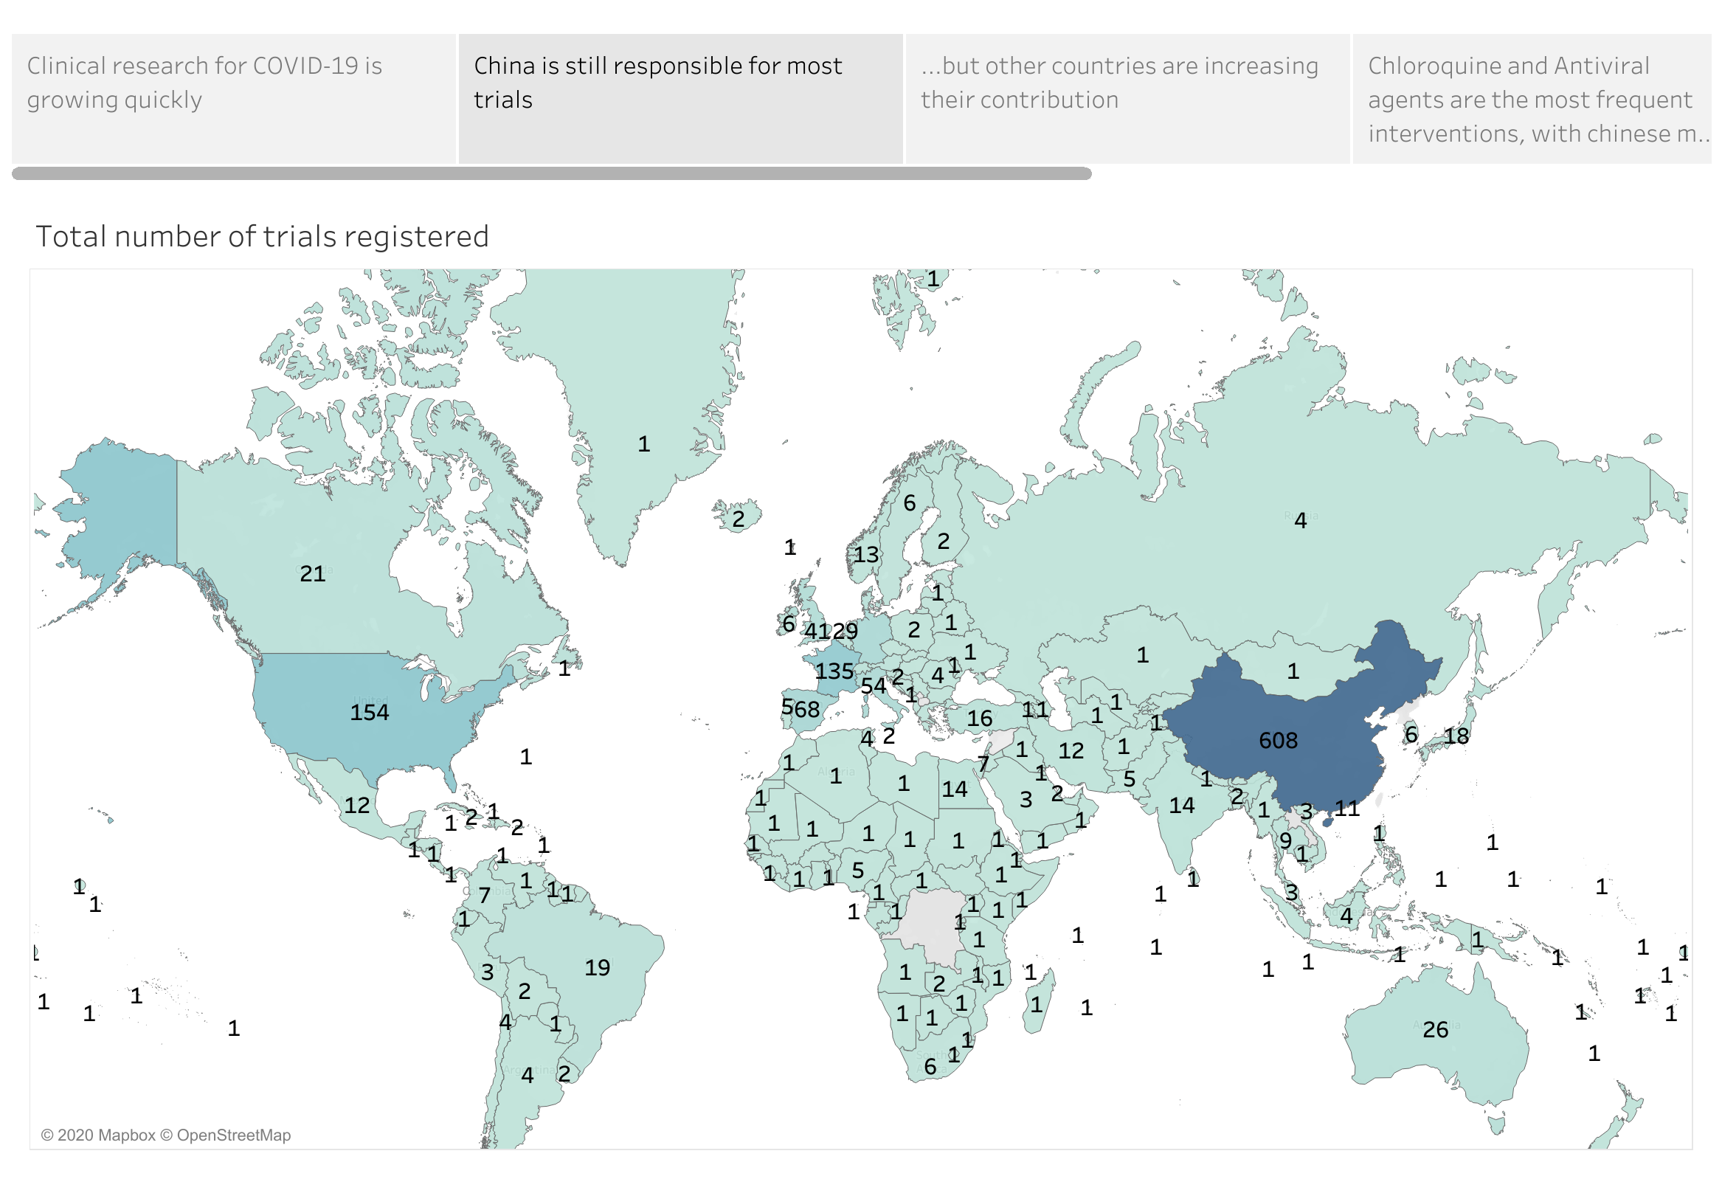

Slide 4
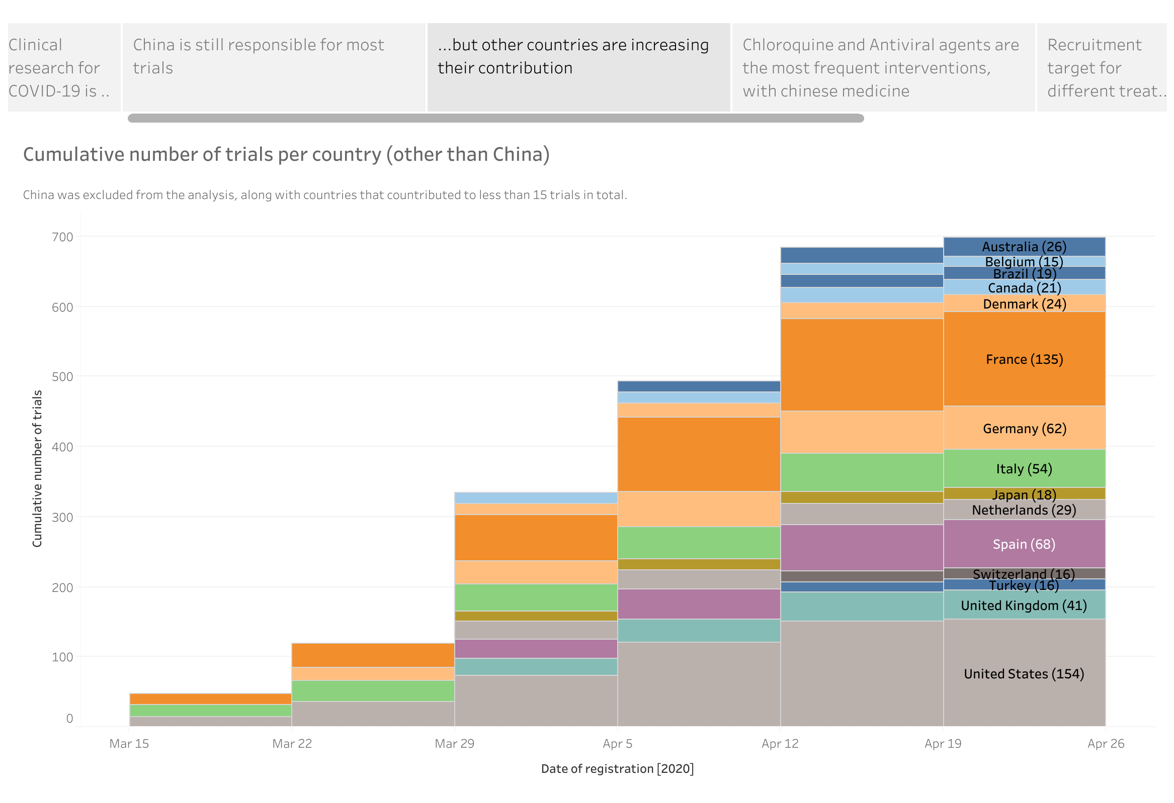

Slide 5
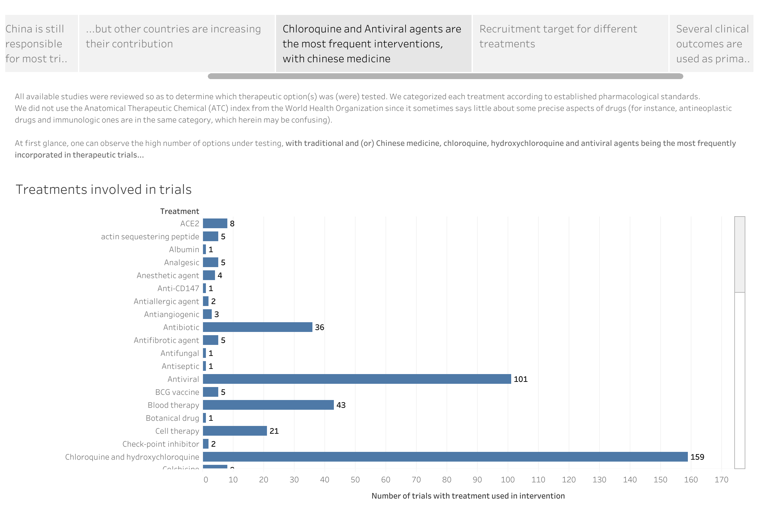

Slide 6
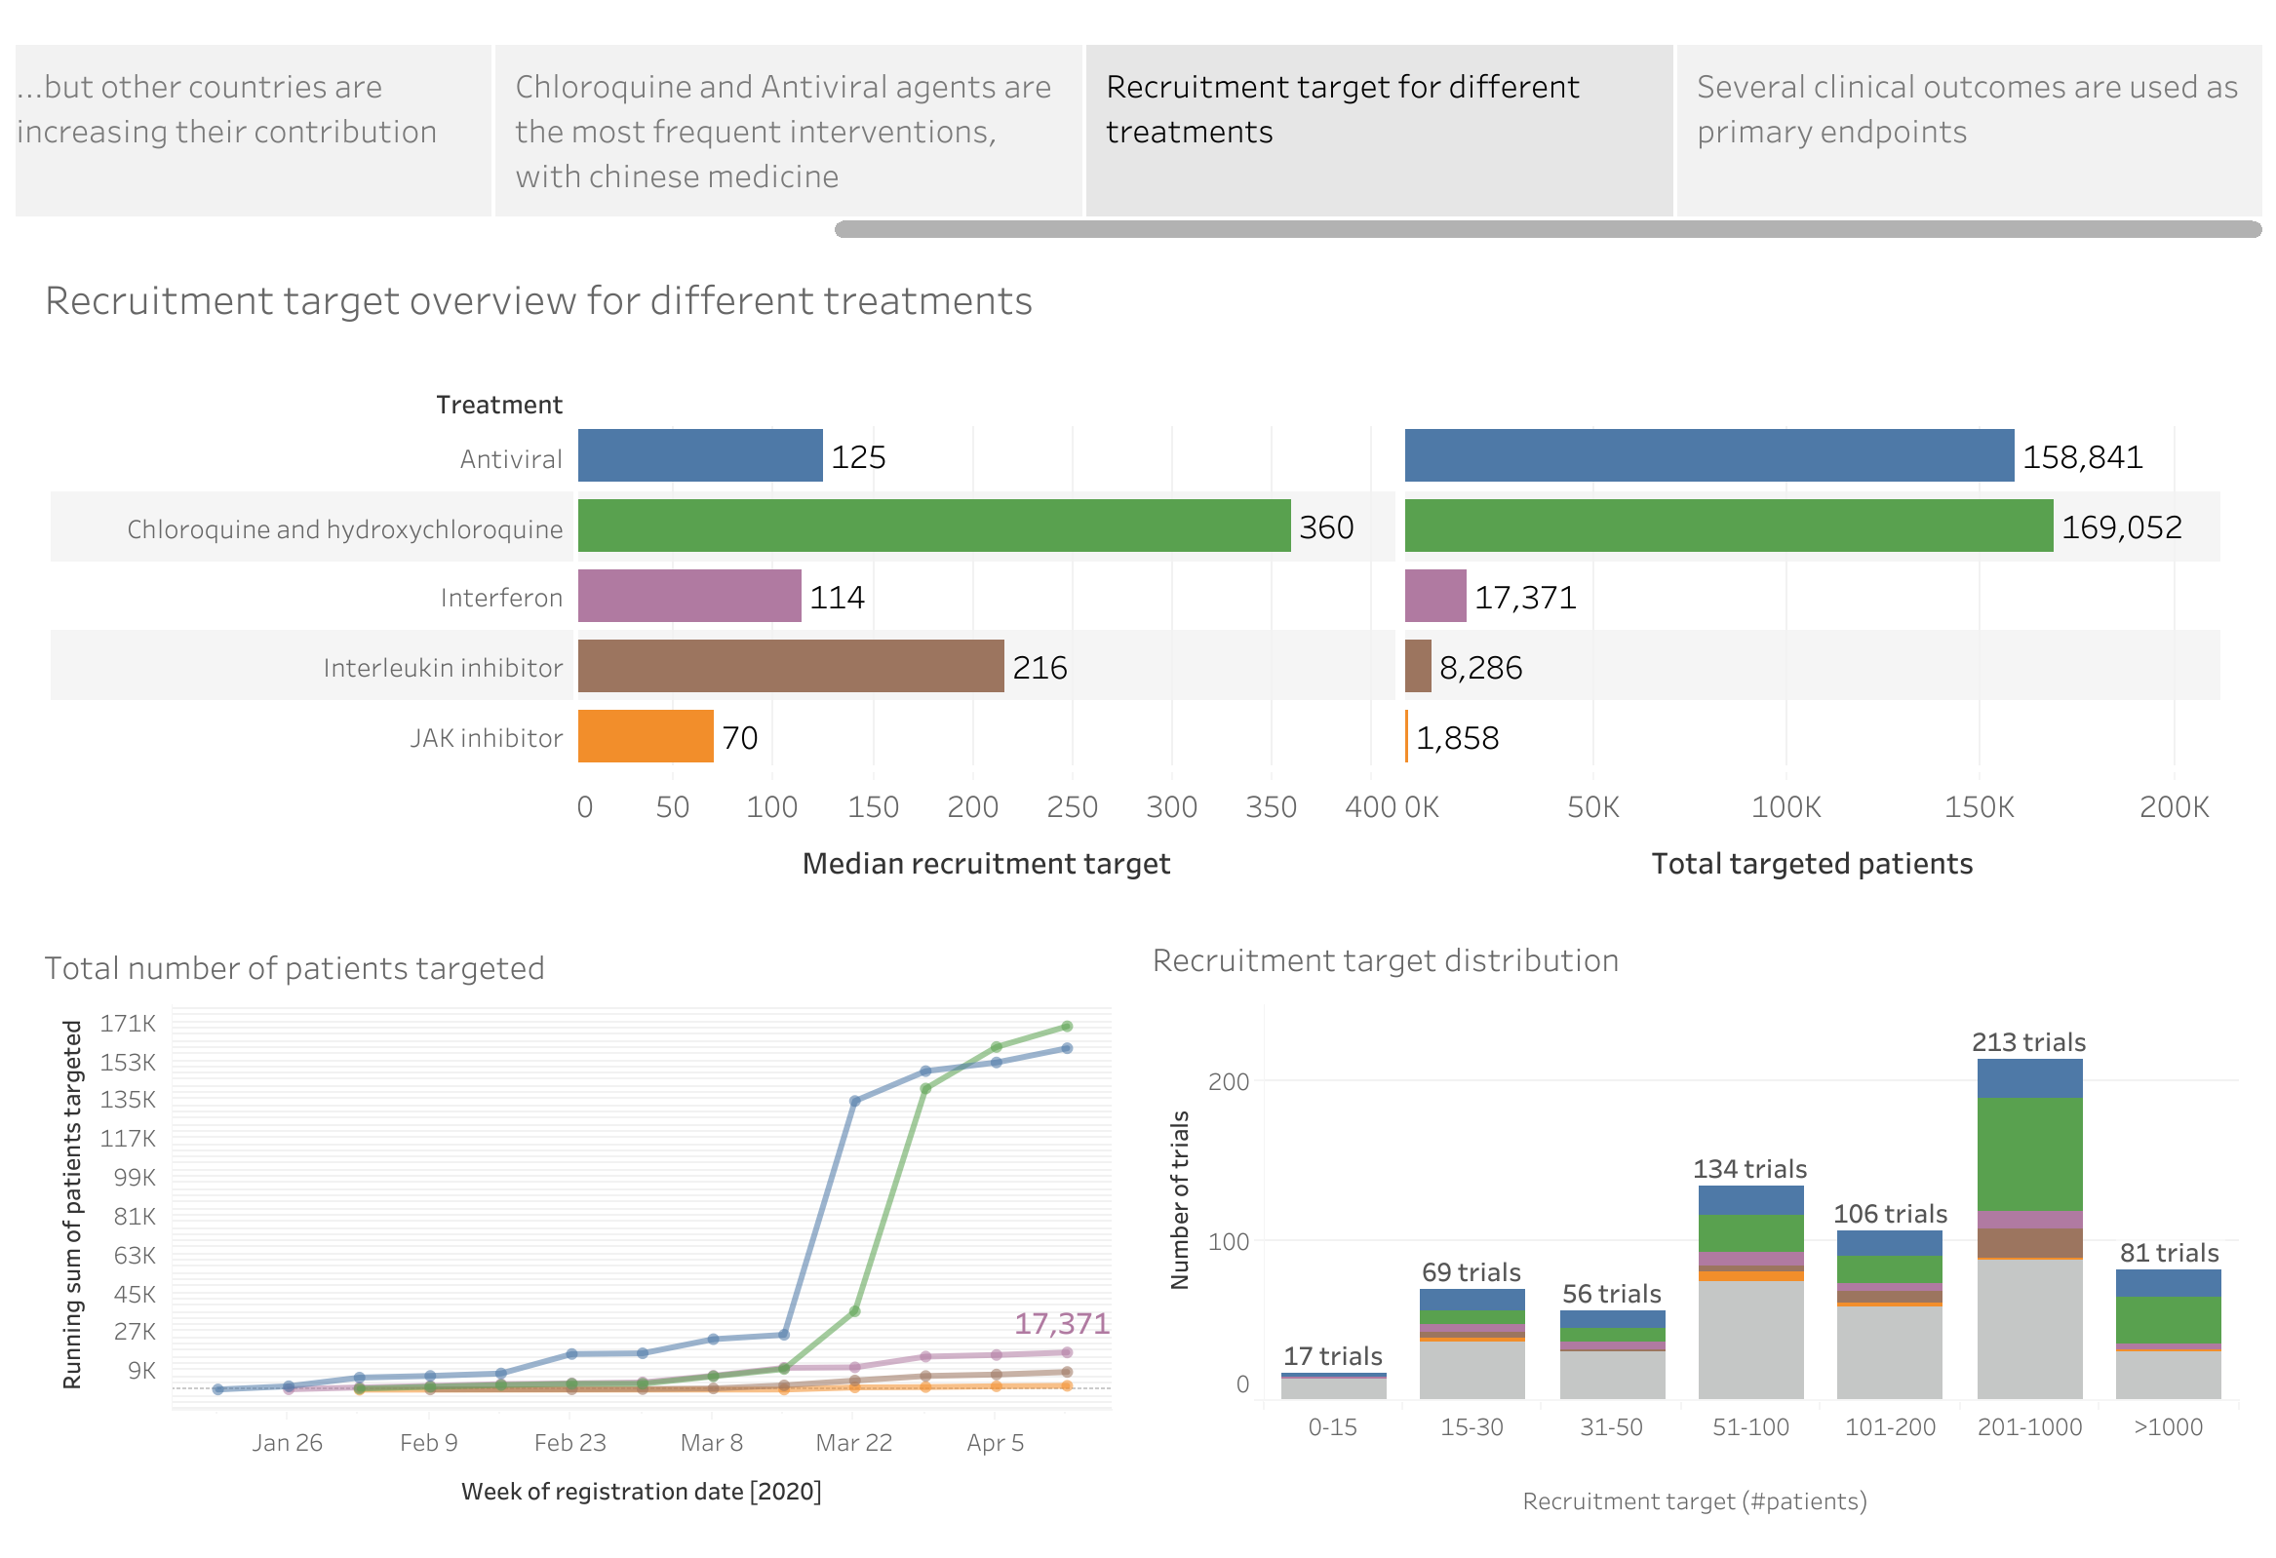

Slide 7
